Slide 1
Amazon sales analysis
Tamilbharathi
27.01.2026

Slide 2
introduction
Amazon is one of the world’s largest e-commerce platforms, generating massive amounts of sales data daily. Analyzing this data helps understand customer behavior, sales trends, top-performing products, and regional performance.
Power BI is a business intelligence and data visualization tool that transforms raw data into interactive dashboards and reports. It helps users explore data, identify insights, and make data-driven decisions quickly and effectively.
A Power BI dashboard can simplify analysis and provide actionable insights.

Slide 3
Data overview
Source: Amazon sales Excel database
Data Fields:
Order ID
Product Name & Category
Product ID
Units Sold & Quantity
Amount
Order Date
Customer Location
CityID
Payment method

Slide 4
Data cleaning and loading
The Best Tool For Cleaning And Preprocessing The Data Is Called As Power Query Editor.
Power Query Is used for cleaning and preprocessing the data.
It Is Used For Extracting The Data, Transforming The Data And Loading The Data Into Power Bi.
Data Cleaning:
Missing values removed.
extract month, year and day from order date.
Append the two year data into one using append queries.
Segregate the product column and creating a separate table.
Segregate the city column and creating a city table.
Removing the duplicate values.

Slide 5
Problem statement
Amazon sales data is large and complex, making it difficult to analyse sales performance and identify meaningful patterns using traditional methods.
Without proper visualization and analysis, it becomes challenging to track sales trends, evaluate product performance, and make informed business decisions.
This project aims to address this problem by developing an Amazon Sales Analysis Dashboard using Power BI that converts raw sales data into interactive and insightful visualizations for effective analysis and decision-making.

Slide 6
Key metrics and kpi’ s
- Total Sales: $216M
- Total Orders: 2K
- Total Quantity Sold: 7K
These KPIs give a quick snapshot of business performance

Slide 7
questions
1.Overall Sales Trend Analysis.
2.Top Selling Category Based on Sales.
3.Identify Top 10 Products by Sales.
4. Analyse City-Wise Sales Trend.
5.Identify orders by each city.
6.Month To Month Analysis and Its Difference.
7.Identify orders based on payment method.

Slide 8
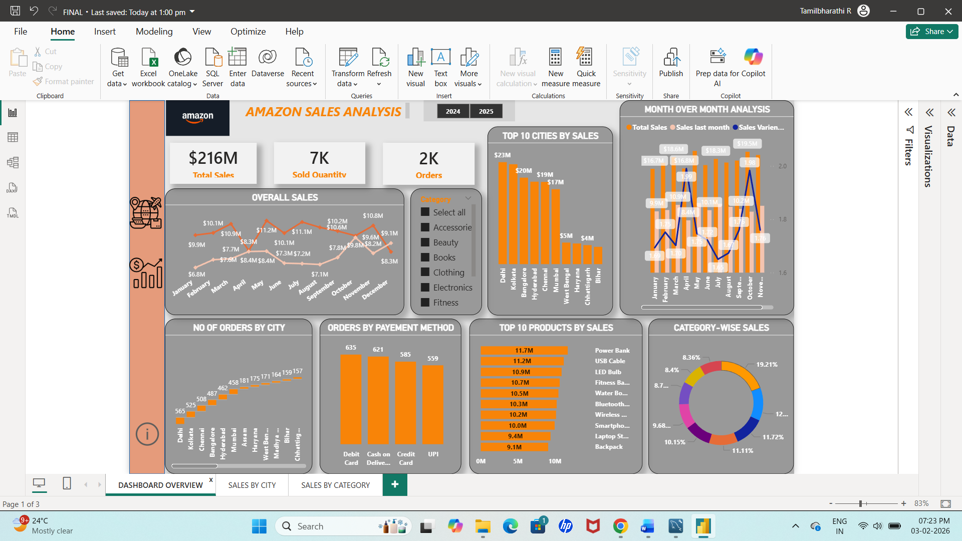
Power bi dashboard overview

Slide 9
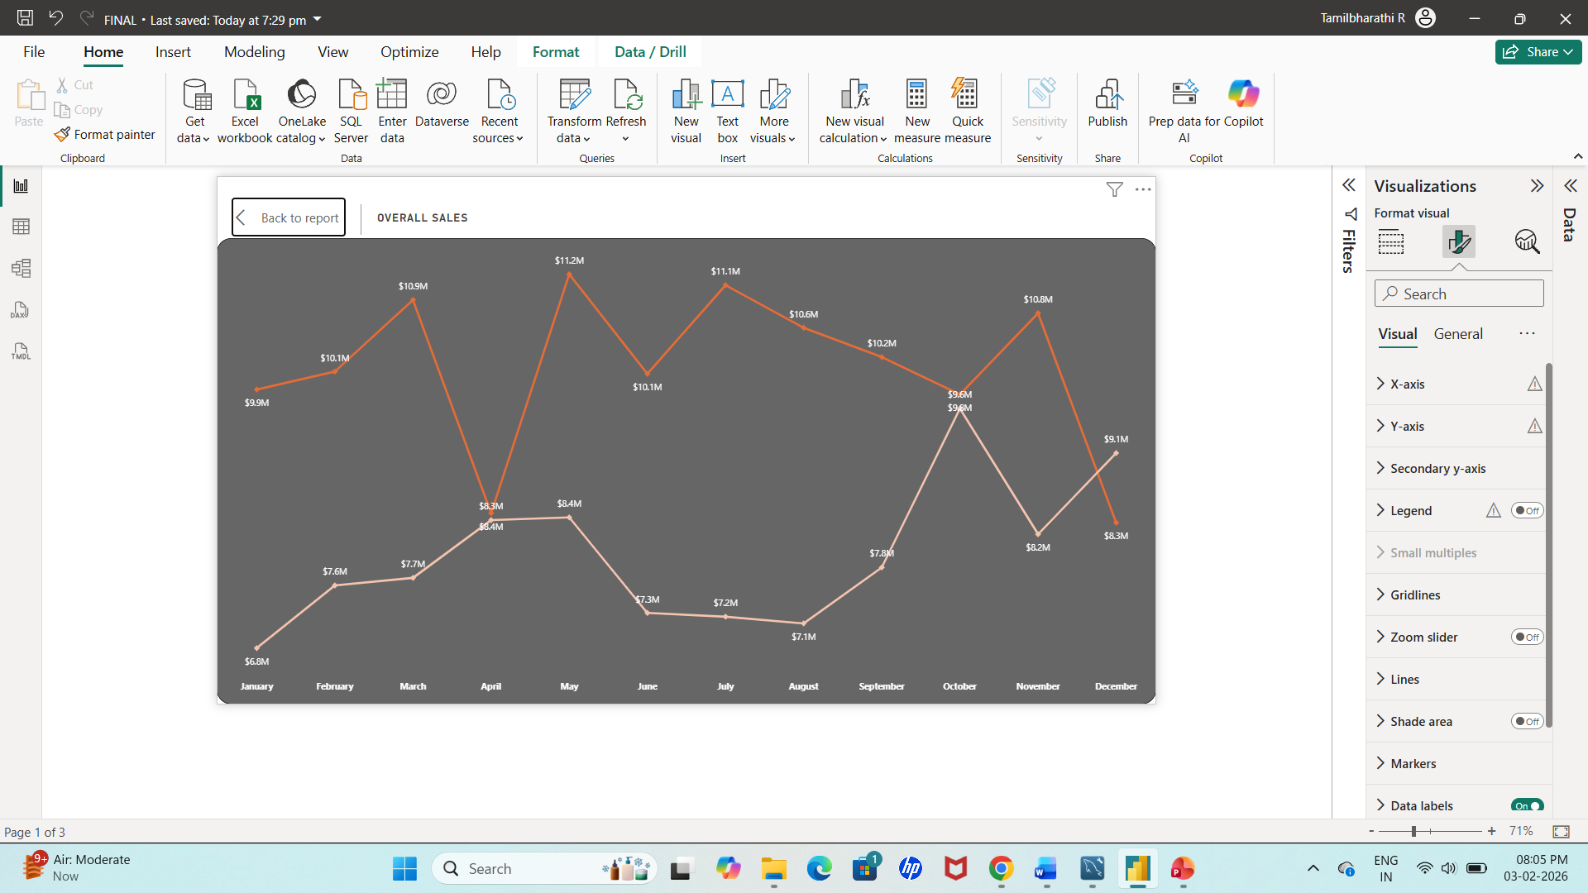
overall sales trend analysis
Line Chart → Best for showing trends over time
X-axis: Months (Jan → Dec)
Y-axis: Revenue ($)
Legend: year

Slide 10
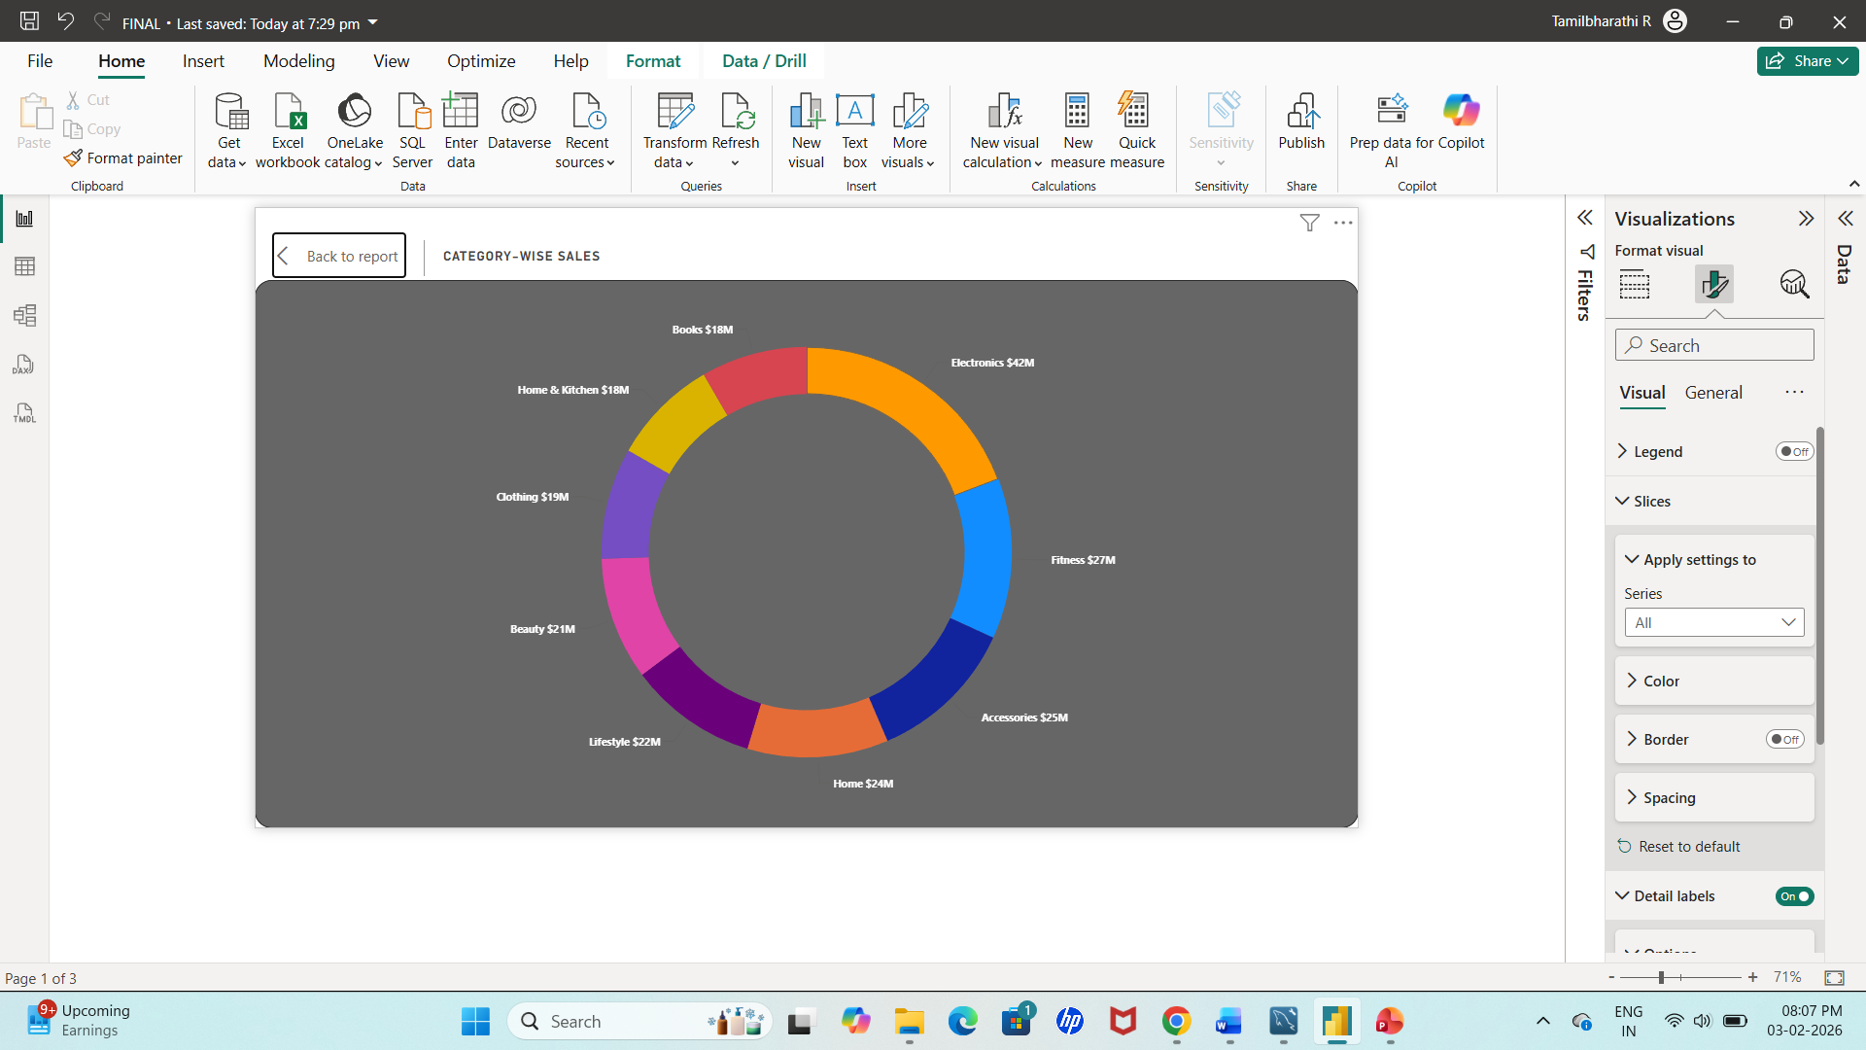
Top selling category based on sales
Donut chart→ Shows Percentage contribution of each category to total revenue
Legend: category
Values: percentage of total revenue

Slide 11
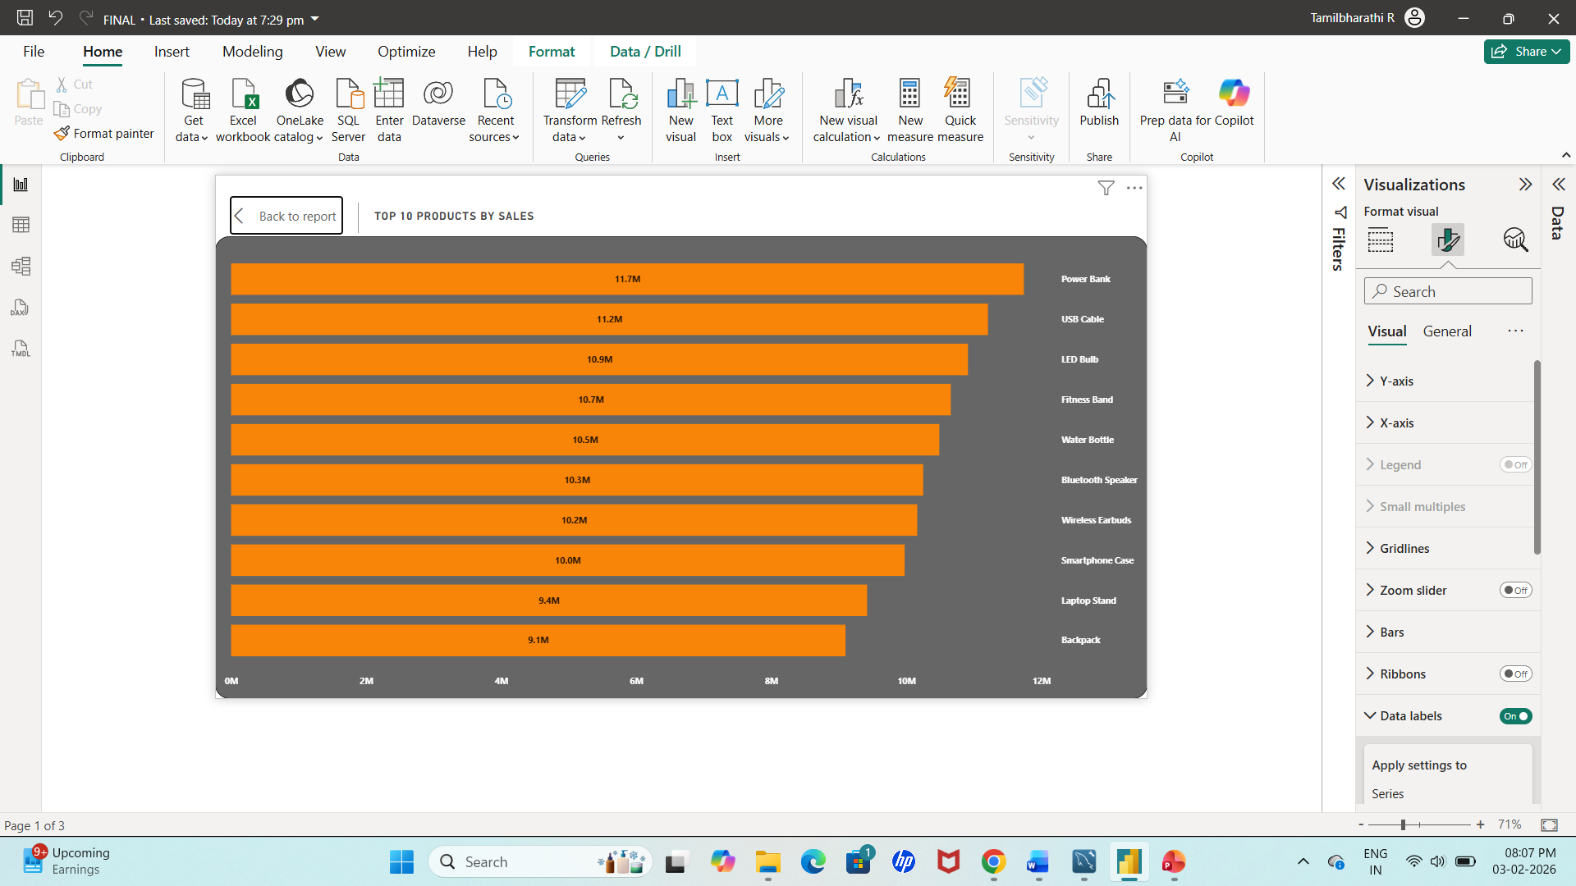
Identify Top 10 products by sales
Stacked bar chart→ horizontal bars are easier to read, it gives quick comparison across products.
Y axis: product name
X axis: Sum of total sales

Slide 12
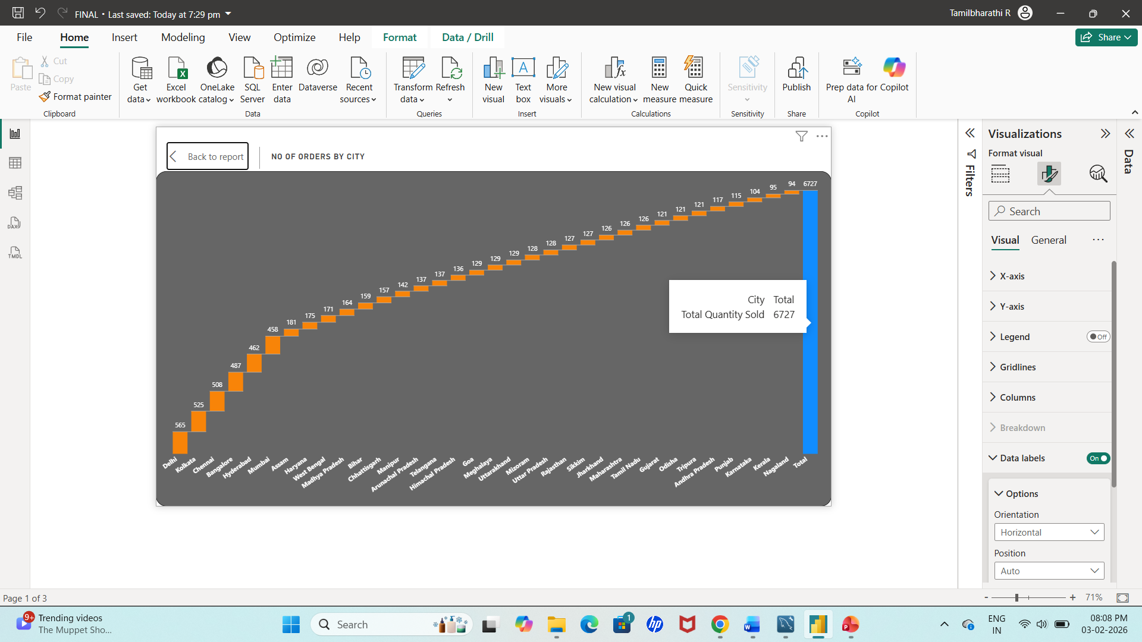
Identify orders by each city
Chart Used: Waterfall chart
X-Axis: City Name
Y-Axis: Number of Orders
Purpose: Shows customer demand and order volume across cities.

Slide 13
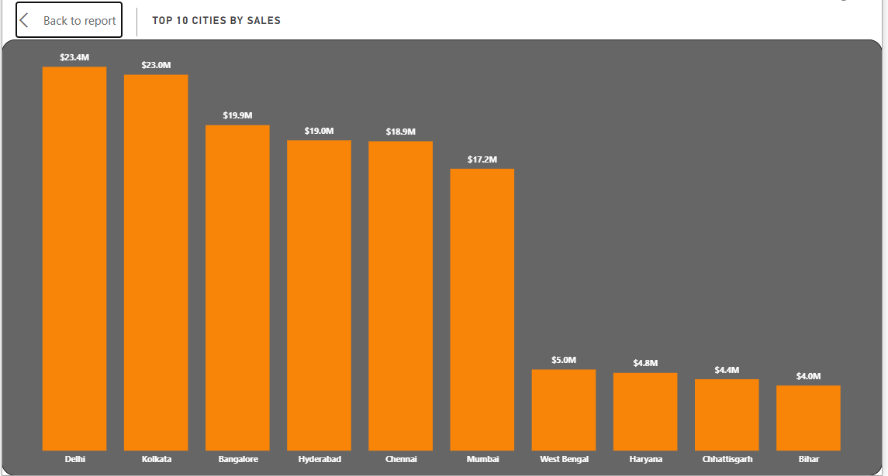
Analyse city-wise sales trend
Chart Used: Vertical Bar Chart
X-Axis: City Name
Y-Axis: Total Sales Amount
Purpose: Identifies cities generating the highest sales.

Slide 14
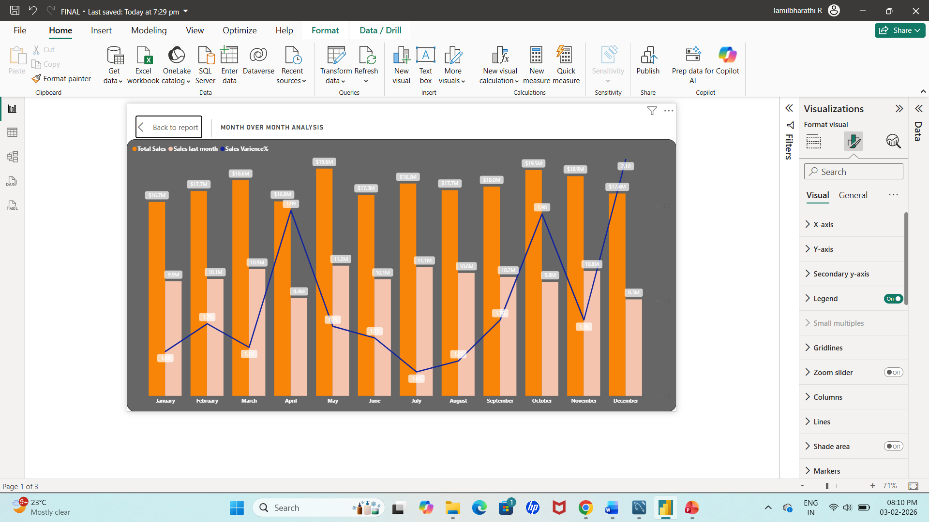
Month over month analysis and its difference
Line And Clustered Column Chart → To evaluate monthly sales performance, measure changes from the previous month, and identify positive or negative variance in revenue and quantity.
X axis: order date(month)
Column Y axis: total revenue, sales last month
Line y axis: sales varience%

Slide 15
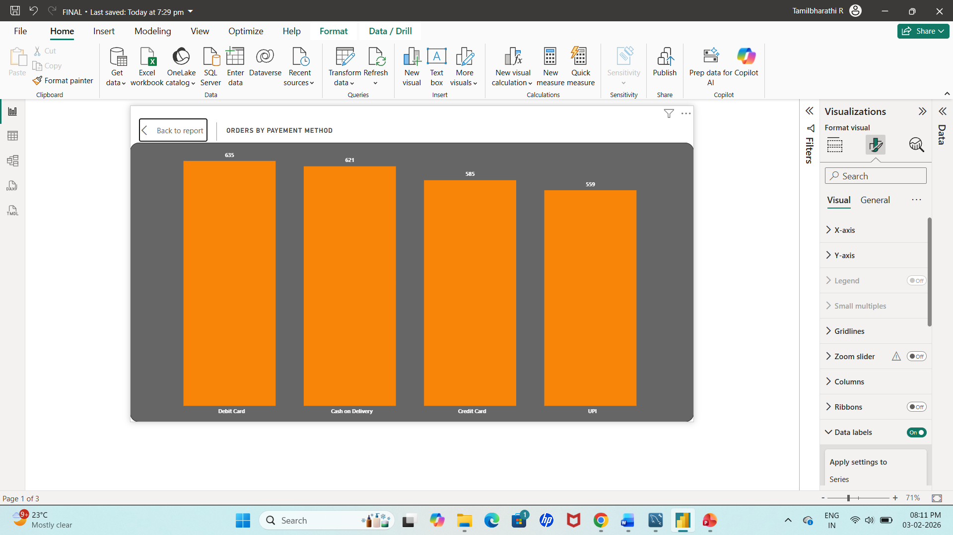
Identify orders based on payment method
Chart Used: Bar Chart
X-Axis: Payment Method (Debit Card, Credit Card, UPI, Cash on Delivery)
Y-Axis: Number of Orders
Purpose: Analyzes customer payment preferences.

Slide 16
Dax Measures used
Total Sales = SUM('Amazon sales'[Total_Sales])
Total Orders = DISTINCTCOUNT('Amazon sales'[Order_ID])
Total Quantity Sold = sum('Amazon sales'[Quantity])
Sales last month = CALCULATE([Total Sales],PARALLELPERIOD('Calender'[Order_Date],-1,MONTH))
Sales Varience = [Total Sales]-[Sales last month]
Sales Varience% = DIVIDE([Total Sales],[Sales last month])

Slide 17
conclusion
The Amazon Sales Dashboard In Power BI Provides A Comprehensive View Of Sales Trends, Product Performance, And Regional Insights, Enabling Data-driven Decisions And Optimized Business Strategies
In Trend Identification It Enables Spotting Seasonal Trends, Peak Months, And Declining Periods, Helping In Proactive Planning.
In Performance Monitoring The Facilitates Of Continuous Tracking Of Kpis Like Revenue, Orders, And Quantity, Allowing Timely Interventions For Business Optimization.

Slide 18
Thank you

